Slide 1

Interpreter vs Compiler Profiler
CD HACKATHON
 | Under the Guidance of K.S.Niraja Department of Computer Science and Engineering, KLH CSE Bowrampet Campus
Team Members G.V.S Hasini-2420030735 G.Hemalatha-2420030703 K.Akshitha-2420030657 N.Divya-2420030733

Slide 2

Outline of Project Work
Focus
Introduction
Literature Survey
Challenges
Research Objectives
Conclusion & Future Work
References
Publications Details

Slide 3
Problem Statement
The main objective of the Interpreter vs Compiler Profileris to analyze and compare the performance of interpreted and compiled programming languages. The system measures execution time, memory usage, and overall performance when running the same program using an interpreter and a compiler.
It helps users understand the differences between interpretation and compilation by executing programs, collecting performance metrics, and presenting the results through graphs and comparisons. This allows users to identify which execution approach is more efficient for different types of programs.

Slide 4
Objectives
Performance Analysis:To compare the execution speed of interpreted and compiled programs.
2. Execution Time Measurement:To measure and analyze the time taken by both approaches to execute the same program.
3. Memory Usage Analysis:To monitor and compare the memory consumed during program execution.
4. Efficiency Comparison:To identify which approach provides better performance under different conditions.
5. Result Visualization:To display the performance comparison using graphs, charts, and reports.
6. Understanding Execution Methods:To help users understand the differences between interpreters and compilers.
7. Optimization:To identify performance bottlenecks and understand how program execution can be improved.

Slide 5
Literature Survey
Authors | Title of the Paper | Methodology | Inferences | Limitation/Future work
Pereira, R. et al. (2021) | Ranking Programming Languages by Energy Efficiency | Evaluated 27 languages based on time, memory, and energy. | Languages differ in performance and energy usage. | Limited benchmark problems; future work can include real-world applications.
Zhang, Q. et al. (2022) | Quantifying the Interpretation Overhead of Python | Analyzed Python interpreter overhead using profiling. | Interpretation introduces execution overhead. | Focused on CPython; future work can compare different interpreters.
Pereira, R. et al. (2017) | Energy Efficiency Across Programming Languages: How Do Energy, Time, and Memory Relate? | Compared languages using standard benchmarks. | Execution time, memory, and energy are interconnected. | Limited tasks; future work can explore modern compilers and hardware.

Slide 6
Problem Gap Identification
1.Lack of Performance Comparison:Existing programming environments do not always provide a simple way to compare interpreter and compiler performance side by side.
2. Limited Execution Analysis:Many tools focus on program execution but do not provide detailed comparisons of execution time and memory consumption.
3. Lack of Visual Representation:Performance results are often displayed as raw numbers rather than easy-to-understand graphs and charts.
4. Difficulty in Identifying Performance Differences:Beginners may find it difficult to understand why interpreted and compiled programs have different execution speeds.
5. No Unified Profiling Platform:Users often need different tools to measure execution time, memory usage, and other performance metrics.

Slide 7
Innovation, Creativity, and Novelty
The proposed Interpreter vs Compiler Profiler introduces an innovative approach to analyzing and comparing the performance of interpreted and compiled programming languages. The system automatically executes the same programs using both execution methods and measures important performance metrics such as execution time, memory usage, and CPU utilization. It provides graphical representations, comparison charts, and performance reports to help users understand the differences easily. The creativity of the system lies in combining automated profiling, performance analysis, and interactive visualization into a single user-friendly platform. The novelty of this project is that it helps students and developers identify performance differences, understand execution efficiency, and explore optimization opportunities without requiring complex profiling tools.

Slide 8
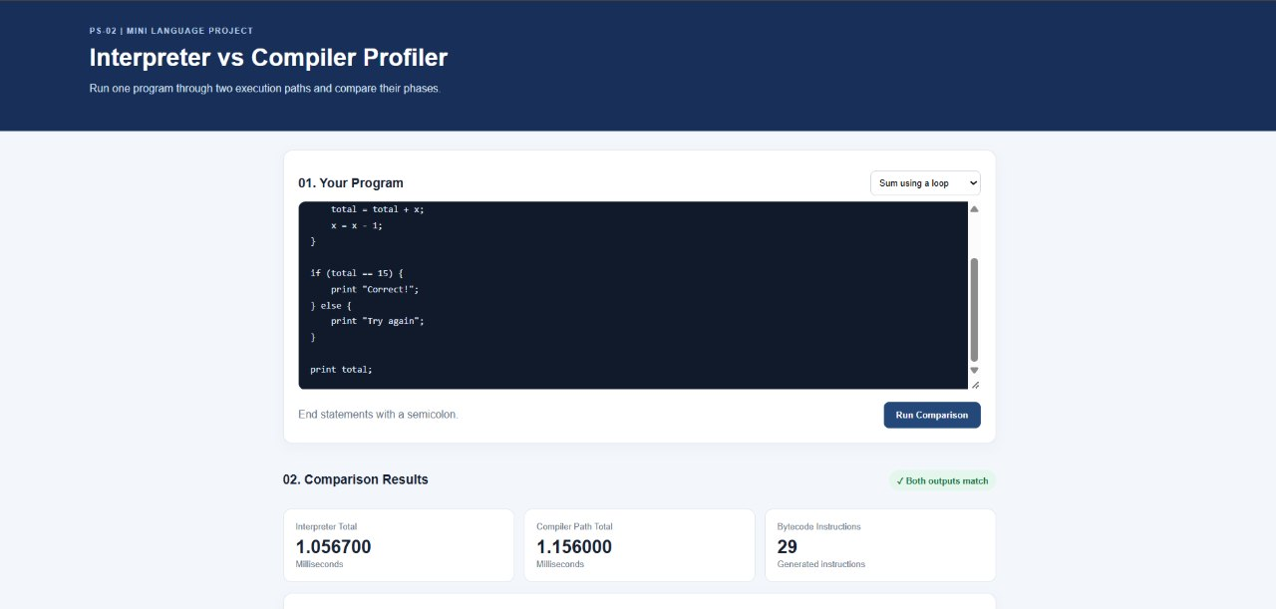

Slide 9


